Slide 1


Machine Learning Introduction

Slide 2


Machine Learning: Solving Problems Big, Small, and Prickly

Slide 3





Why Study Machine Learning: A Few Quotes
“A breakthrough in machine learning would be worth ten Microsofts” - (Bill Gates, Microsoft)
“Machine learning is the next Internet” - (Tony Tether, Former Director, DARPA)
“Software Is Eating the World, but AI Is Going to Eat Software” - (Jensen Huang, CEO, NVidia)
“Web rankings today are mostly a matter of machine learning” - (Prabhakar Raghavan, Dir. Research, Yahoo)
“Machine learning is going to result in a real revolution” - (Greg Papadopoulos, CTO, Sun)
02

Slide 4
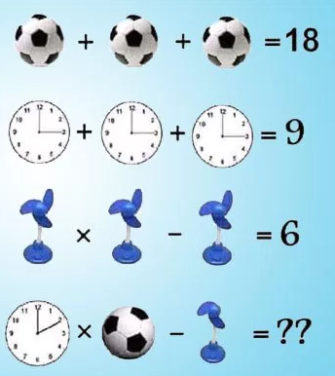
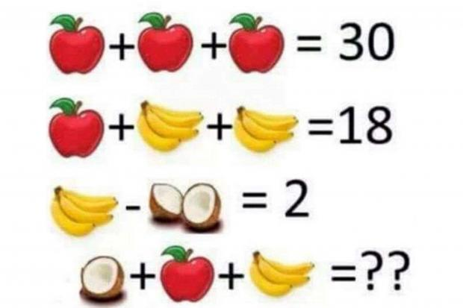
Puzzle : A peek into Human Learning
03

Slide 5
Machine Learning
Jeff Bezos in his 2016 letter to Amazon shareholders :
Over the past decades computers have broadly automated tasks that programmers could describe with clear rules and algorithms. Modern machine learning techniques now allow us to do the same for tasks where describing the precise rules is much harder.
04

Slide 6
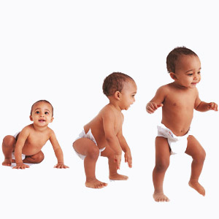
What is Learning?
Learning takes place as a result of interaction between an agent and the world
The idea behind learning is,
“Percept received by an agent should be used not only for acting, but also for improving the agent’s ability to behave optimally in the future to achieve the goal.”
05

Slide 7
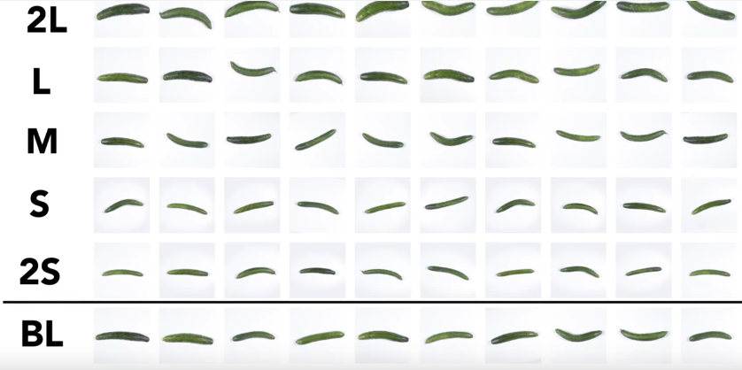
What is Machine Learning?
The ability to perform a task in a situation which has never been encountered before (Learning = Generalization)
Sorting Cucumbers
Automating automation
Getting computers to program themselves
Writing software is the bottleneck
Let the data do the work instead!
06

Slide 8

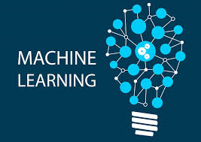
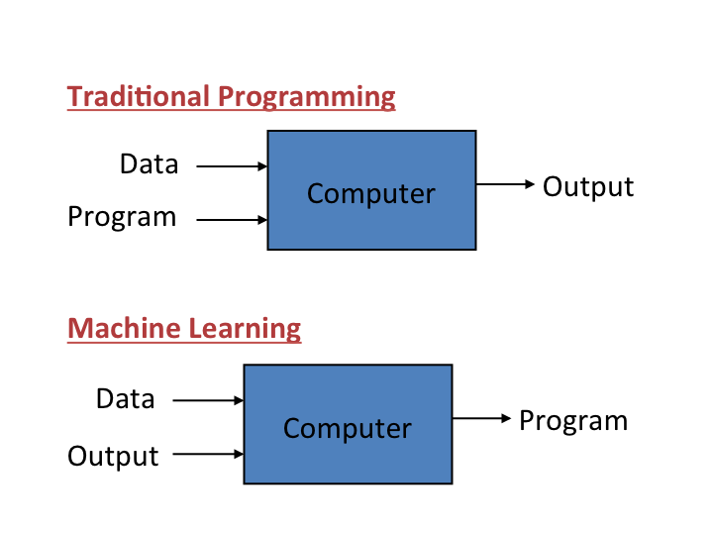

Traditional Programming Vs Machine Learning
07

Slide 9
Why ML?
Data availability:
The amount of digital data being generated is huge
This data can be analysed to make intelligent decisions
Computation power:
Current hardware has the capability to reliably store and analyse the massive data and perform massive amount of computations in a reasonable amount of time.
This allows to build complex Machine Learning models with billions of parameters which was not possible a decade ago.
08

Slide 10


Widely used Applications
09

Slide 11
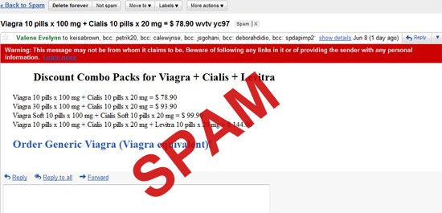
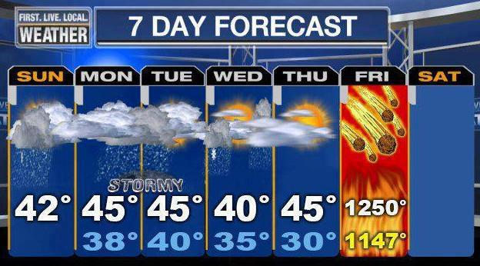
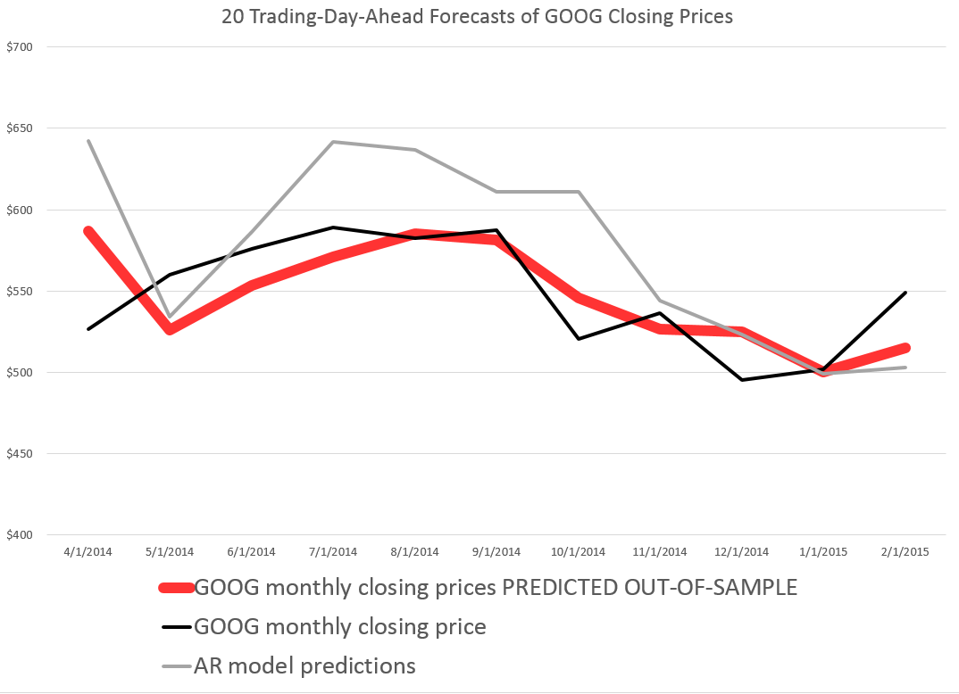
ML applications
HAM
10

Slide 12
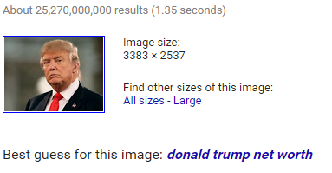
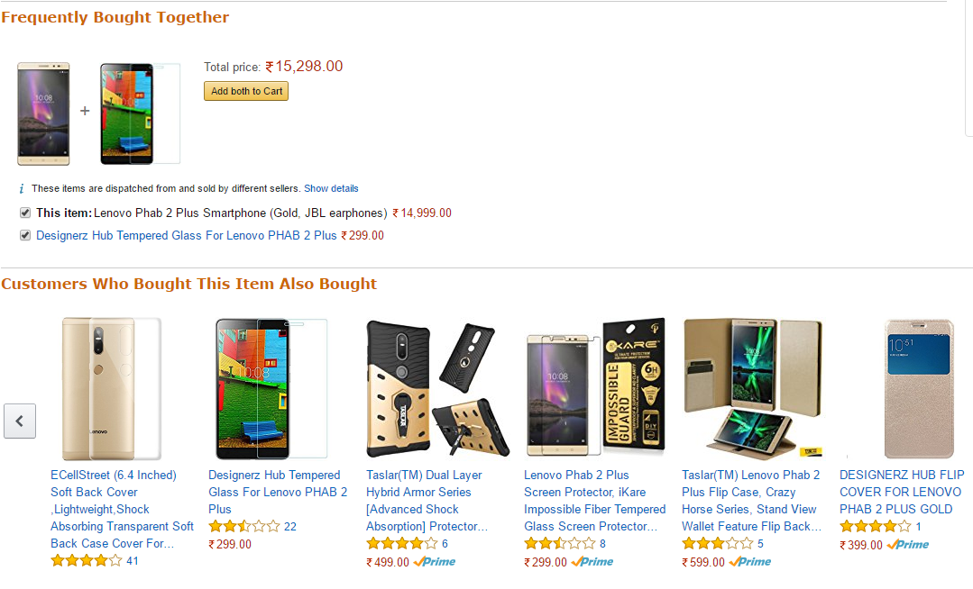

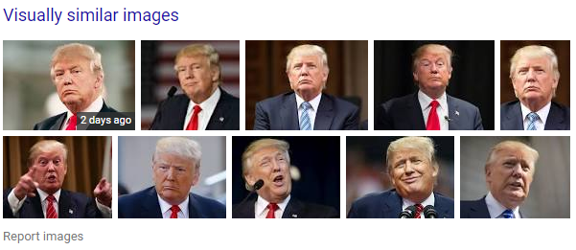
ML applications …
11

Slide 13
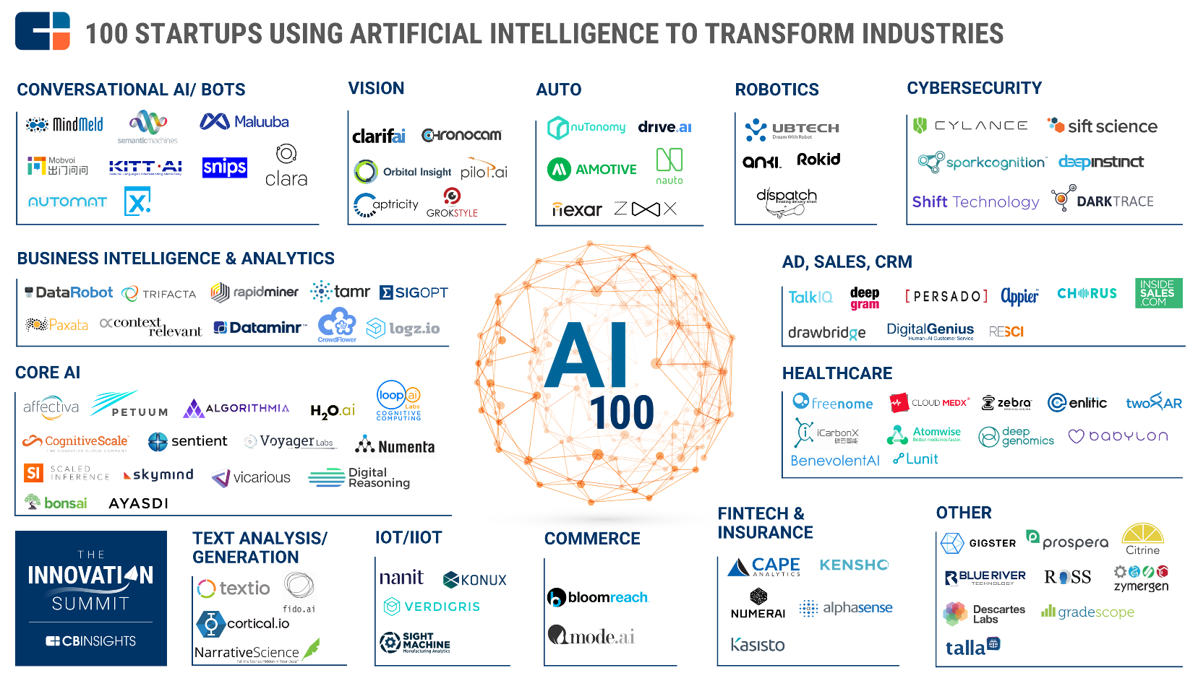
A Look at growth in AI Startups Preview into emerging AI Applications
12

Slide 14
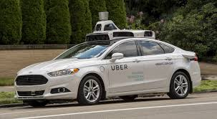
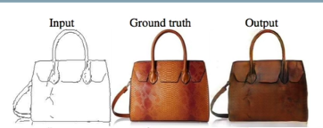
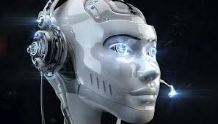
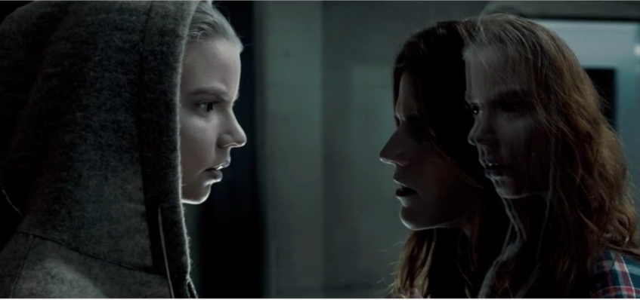
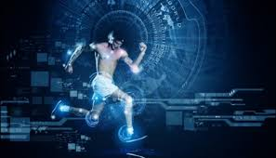
ML/AI going to transform & create new Industries
13

Slide 15
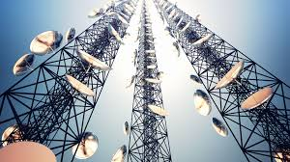
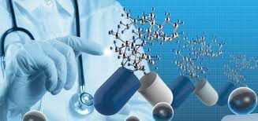
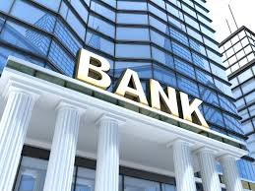
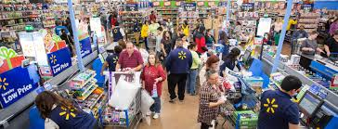


Analytics in Industries/Institutions
14

Slide 16
Machine Learning Process
15

Slide 17
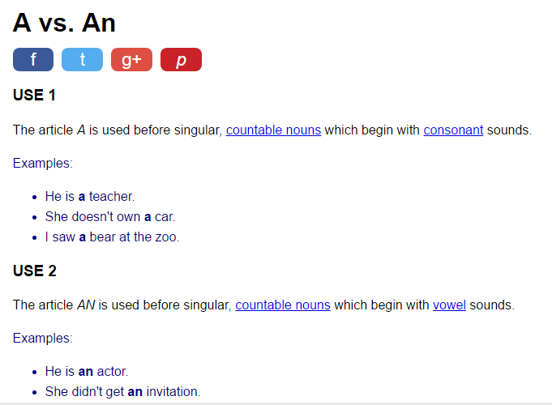
Learning Articles: A vs. An
8 Rules on the website
Source: http://www.englishpage.com/articles/a-vs-an.htm
16

Slide 18

Analogy: Is ML a Magic?
No, its more like gardening
Gardener = You
Seeds = Algorithms
Nutrients = Data
Plants = Programs
Fruits and Flowers = result
17

Slide 19
ML Terminologies
The number of features or distinct traits that can be used to describe each item in a quantitative manner.
Features
Samples
Feature vector
Feature extraction
Training/Evolution set
Test/Validate set
Scoring
The number of features or distinct traits that can be used to describe each item in a quantitative manner.
The number of features or distinct traits that can be used to describe each item in a quantitative manner.
Preparation of feature vector
Transforms the data in the high-dimensional space to a space of fewer dimensions.
Set of data to discover potentially predictive relationships.
Set of data to validate the predictive relationship
Evaluating the performance based on statistical metric
18

Slide 20
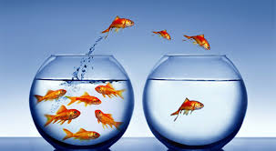
ML Terminologies with example Telecom Customer Churn
Raw Features
Subset of customer base for analysis
Demographics, usage pattern, Customer satisfaction, call quality, Competitor info, Sentiment etc.
Samples
Feature extraction
Training set
Test/Validate set
Process of transforming raw data into representative information for a given customer.
Ex: %ge drop in MoM usage
Scoring
Feature vector
Summary representation of attributes of each customer
19

Slide 21
Types of Learning
Supervised Learning
Unsupervised Learning
Reinforcement Learning
Face Detection
Taxonomy
Playing Chess
20

Slide 22
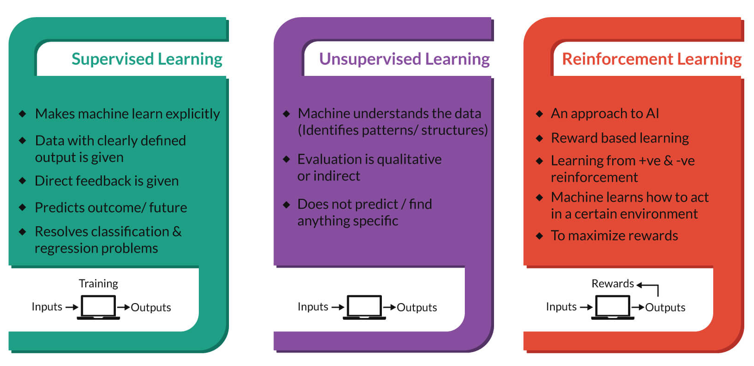
Types of Learning
21

Slide 23
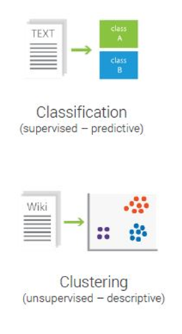
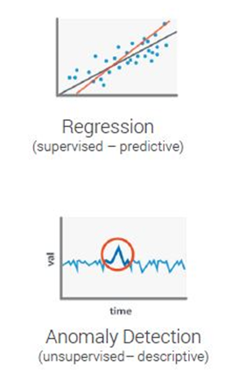

Machine Learning: Problem Type
Game Playing
(Reinforcement Learning)
22

Slide 24
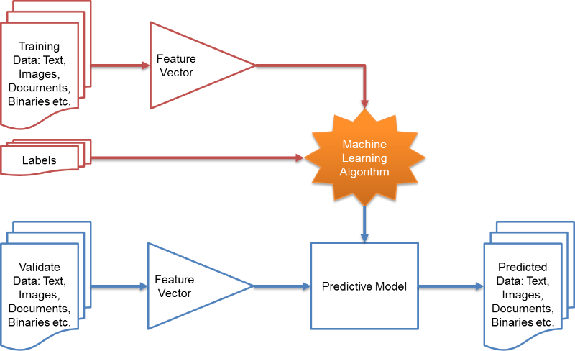
Workflow
Output
23

Slide 25
Modelling
What makes a model?
Difference between a model and a machine learning algorithm? Model is an artificial abstraction where only necessary details are captured
How do you build a model
It is part art and part science
EDA (Exploratory data analysis) Write a functional form for the model Fit the model
Quickly summarise and gain insights about a dataset
24

Slide 26
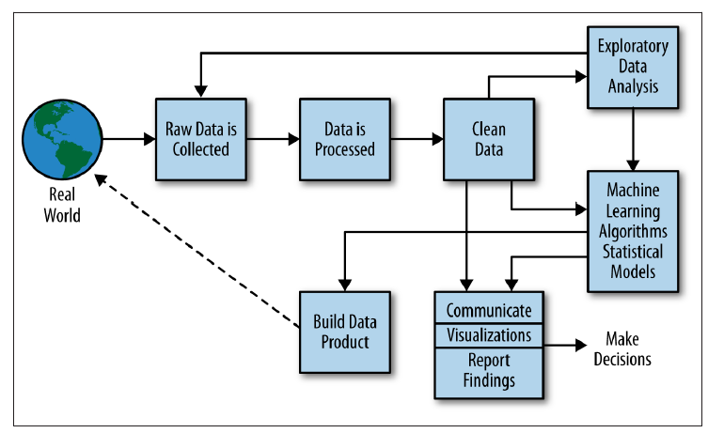
Putting it all together
25

Slide 27
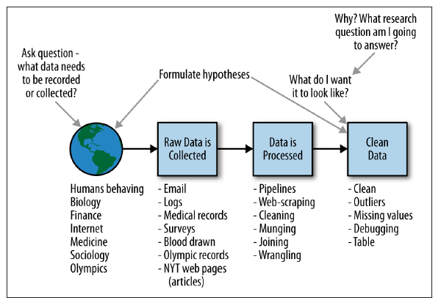
Data Scientist’s role
26

Slide 28
Key Data Scientist Questions
What DECISIONS does my business make?
e.g. Which offer to send to which customer?
On what BASIS do I make those decisions?
e.g. Past purchase behaviours of those/similar customers?
How do I quantify SUCCESS of my decisions?
e.g. What fraction of offers get converted?
What data should I collect to EVALUATE my decisions?
e.g. Did customers redeem the coupons – after how long, how often.
What data should I collect to IMPROVE my decisions?
e.g. Point of sales data, Social data, Reviews, etc.
How do I improve my MODELS from the data I collect?
More data, More features, Better Modelling, More Customization
27

